Slide 1
Terraform Function
OW

Slide 2
Functions
Terraform includes a number of built-in functions that you can call from with in expression to transform and combine values.
The general syntax for functions call is a function name followed by comma-separated in parantheses
max(5, 12, 9)
Terraform doesn’t support user-defined functions.

Slide 3
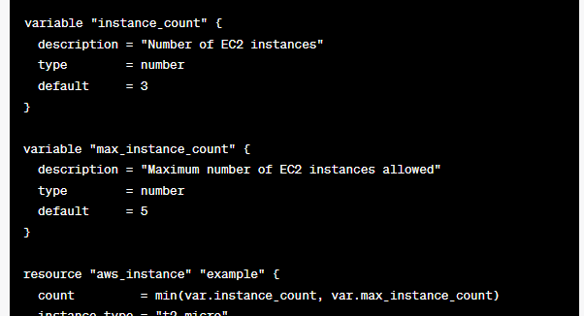
Numeric Functions
Max
Min

Slide 4
string
Chomp
Format
Join
Regex
Replace
Split

Slide 5
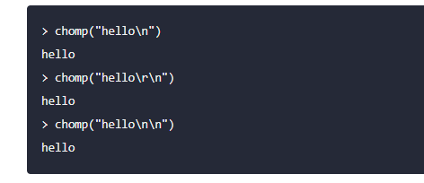
chomp
chomp removes newline characters at the end of a string.
This can be useful if, for example, the string was read from a file that has a newline character at the end.

Slide 6

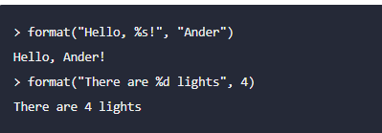
format
The format function produces a string by formatting a number of other values according to a specification string. It is similar to the printf function in C, and other similar functions in other programming languages.

Slide 7

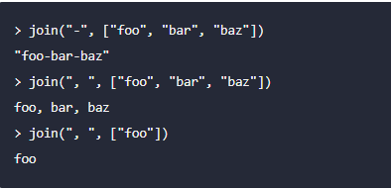
Join
join produces a string by concatenating all of the elements of the specified list of strings with the specified separator.

Slide 8
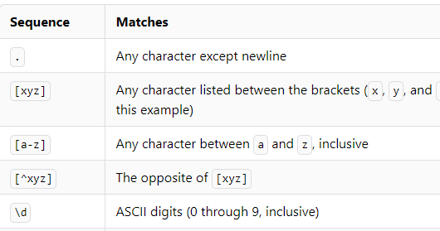
regex
regex applies a regular expression to a string and returns the matching substrings.

Slide 9

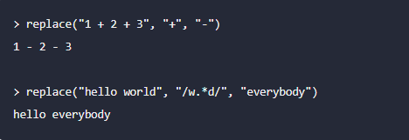
replace
replace searches a given string for another given substring, and replaces each occurrence with a given replacement string.

Slide 10

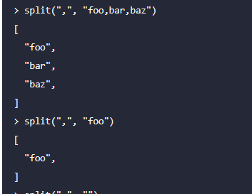
split
split produces a list by dividing a given string at all occurrences of a given separator.

Slide 11
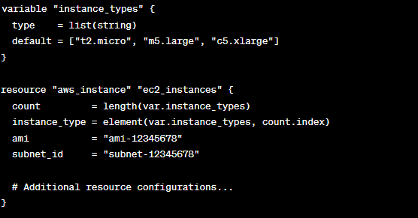
example
In the aws_instance resource block, we use the count argument and set it to the length of the instance_types list. This allows us to dynamically create multiple EC2 instances based on the length of the list.
The instance_type argument is set using the element() function. We pass in the instance_types list and the current index count.index to retrieve the corresponding instance type for each iteration of the resource creation.

